Slide 1
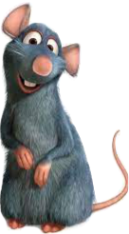
Segmentation and classification of ultrasonic calls as a tool for evaluation of social communication in a mouse model of autism
Biomedical Engineering
Engineering Faculty
Ben-Gurion University Of The Negev
Students:
Lavy Guy
Wolfman Vered
Supervisors:
Prof. Golan Hava
Dr. Lederman Dror

Slide 2
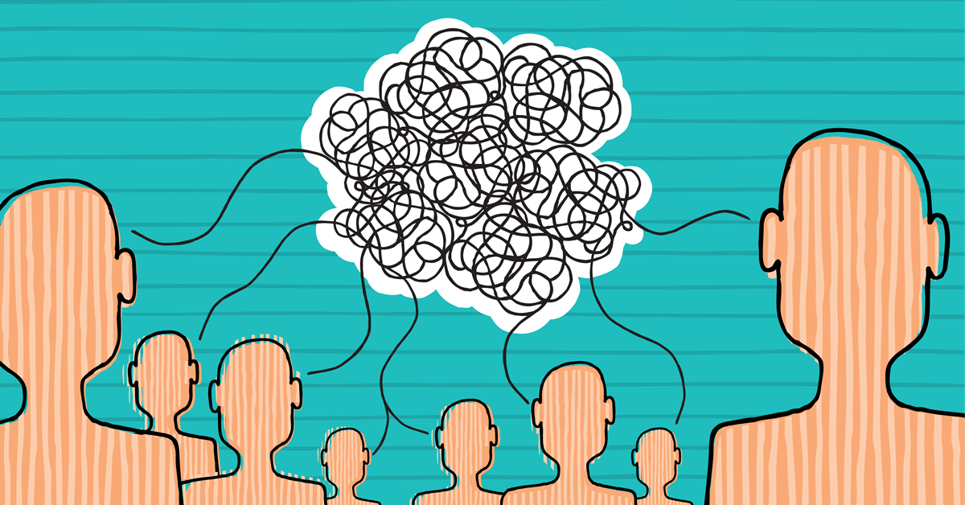

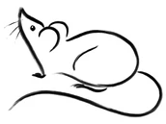
Literature review
What is ASD ?
Average diagnosis age 4 – 5 years
Early age diagnosis is crucial
Current diagnosis methods
Why mice model ?

Slide 3
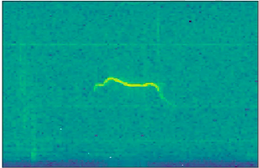
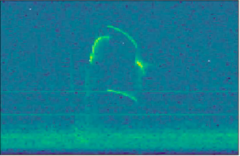
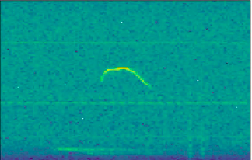
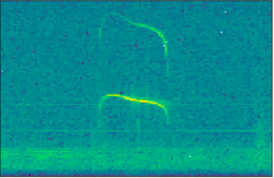
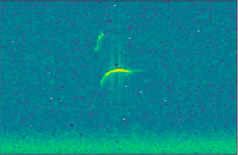
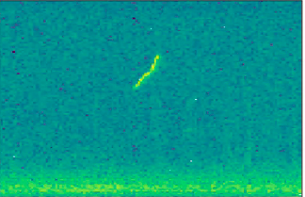
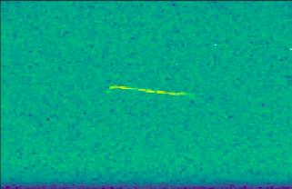
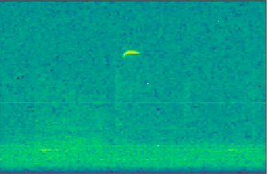
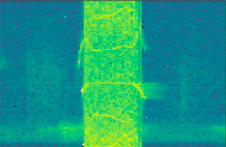
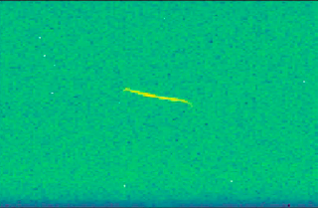

Literature review
USV - UltraSonic Vocalization
10 Categories:
Complex
Frequency steps
Chevron
Composite
Two syllable
Frequency [kHz]
Time [mSec]
Upward
Flat
Short
Harmonics
Downward
Frequency [kHz]
Time [mSec]

Slide 4


Goals
Develop an automatic USV classification model
USV segmentation + classification: healthy mice VS mice with ASD symptoms

Slide 5
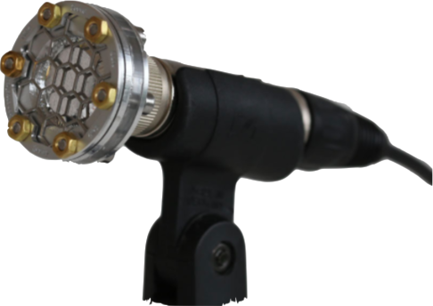
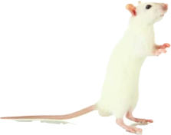
Database background
Database contains 90,000 recordings
Classified dataset contains 5865 syllables
Ultrasonic microphone
Max frequency of mice: 120kHz
Sampling rate of 250kHz
Squeak Squeak Squeak

Slide 6
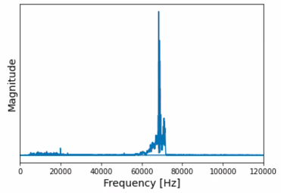
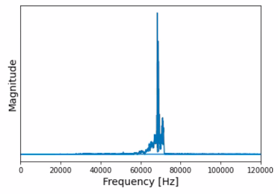
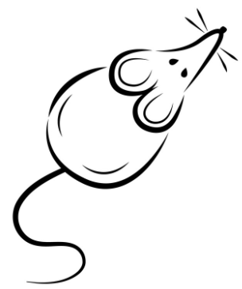
USV’s pre-prossecing
High pass filter
Cutoff frequency - 30kHz
Filter order 6

Slide 7
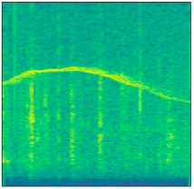
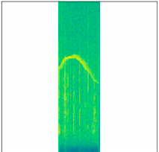
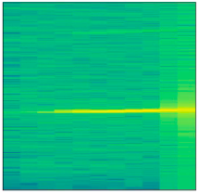
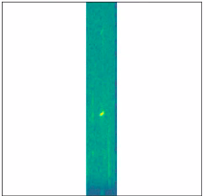
USV’s pre-prossecing
Time axis normalization
Creating new spectrograms - zero padding before & after the syllable
Old spectrograms
New spectrograms

Slide 8
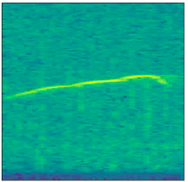
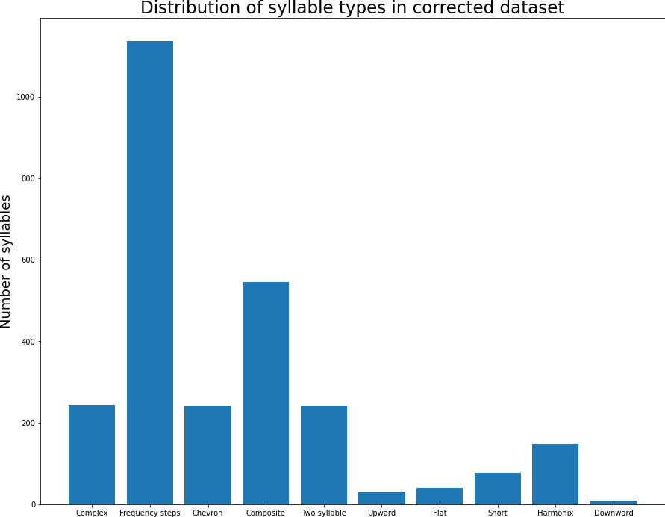
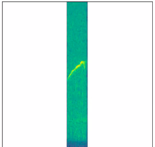
USV’s pre-prossecing
Inconsistent manual classification
Reclassifying the data on the new spectrograms
1137
Upward
546
243
241
241
Complex
149
77
32
40
9

Slide 9
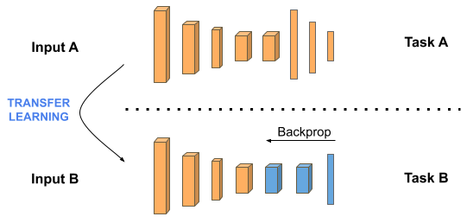
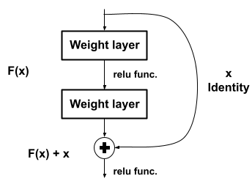
Methods
Deep-learning approach - Convolutional Neural Network
Transfer learning implementation
ResNet-V2-50 architecture

Slide 10
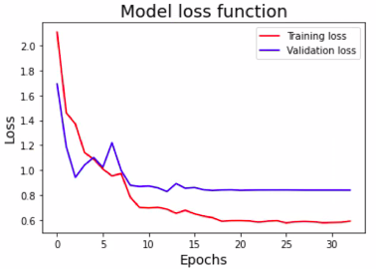
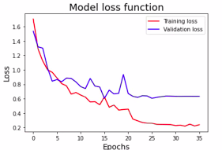
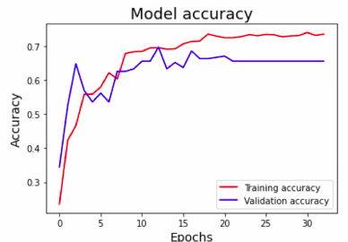
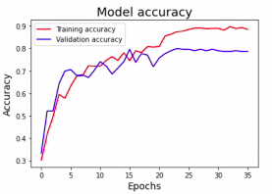
Results
Old data
New data

Slide 11
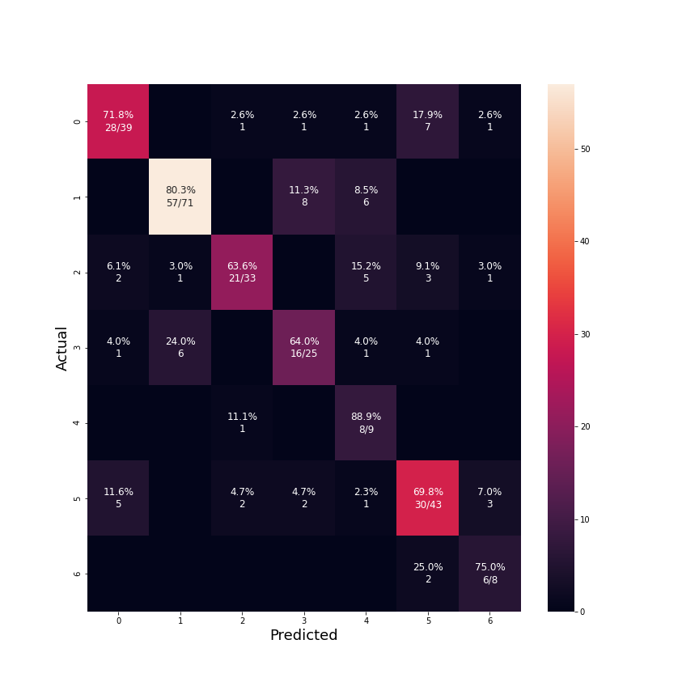
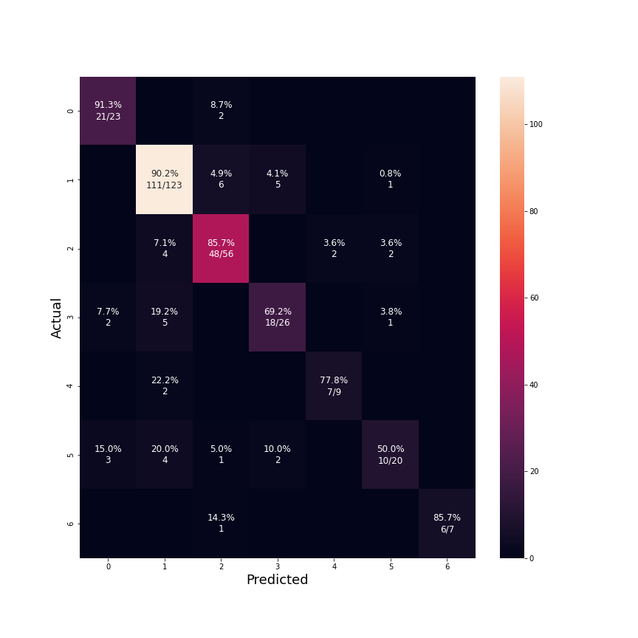
Results - 7 syllable classes
Confusion matrix - Old data
Confusion matrix - New data
0 - Complex
1 - Frequency steps
2 - Composite
3 - Two syllable
4 - Harmonics
5 - Chevron
6 - Short

Slide 12
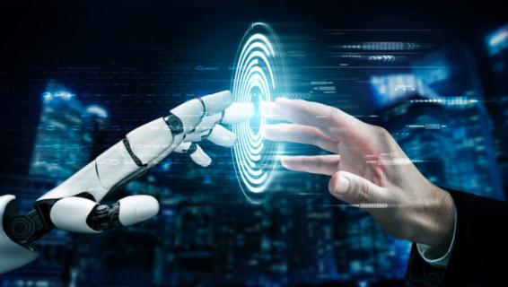
Conclusions & Future steps
Conclusions
Noticeable improvements in results after data fixing and new model
Future steps
Reclassifying the rest of the labeled data-set
Creating a new model based on segmentation and our classification model to distinguish ASD behavior in mice from a complete mouse recording

Slide 13
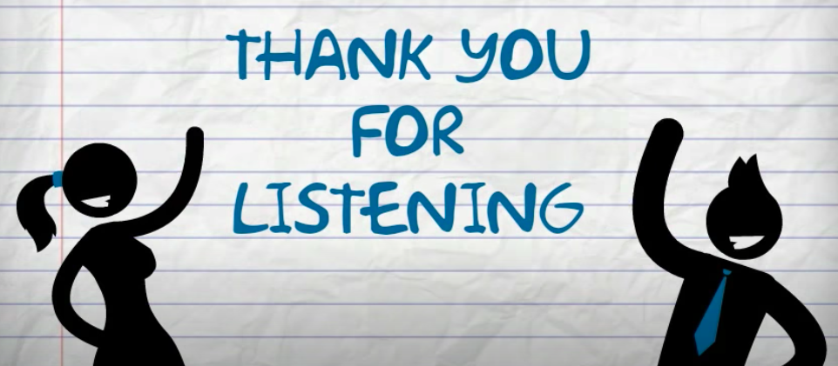

Slide 14
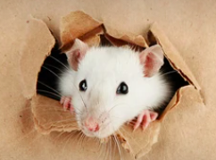
References
[1]A. Masi, M. DeMayo, N. Glozier, and A. Guastella, “An Overview of Autism Spectrum Disorder, Heterogeneity and Treatment Options,” vol. 33, no. 2, pp. 183–193, 2017, doi: 10.1007/s12264-017-0100-y. [2].J. H. Elder, C. M. Kreider, S. N. Brasher, and M. Ansell, “Clinical impact of early diagnosis of autism on the prognosis and parent-child relationships,” vol. 10, p. 283, 2017, doi: 10.2147/PRBM.S117499. [3].N. Sadigurschi and H. M. Golan, “Maternal and offspring methylenetetrahydrofolate-reductase genotypes interact in a mouse model to induce autism spectrum disorder-like behavior,” vol. 18, no. 1, p. n/a, 2019, doi: 10.1111/gbb.12547. [4]. C. P. Johnson and S. M. Myers, “Identification and evaluation of children with autism spectrum disorders,” vol. 120, no. 5, p. 1183, 2007, doi: 10.1542/peds.2007-2361. [5]. A. S. Heinsfeld, A. R. Franco, R. C. Craddock, A. Buchweitz, and F. Meneguzzi, “Identification of autism spectrum disorder using deep learning and the ABIDE dataset,” vol. 17, p. 16, 2018, doi: 10.1016/j.nicl.2017.08.017. [6]. M. L. Scattoni, S. U. Gandhy, L. Ricceri, and J. N. Crawley, “Unusual Repertoire of Vocalizations in the BTBR T+tf/J Mouse Model of Autism (Atypical USVs in BTBR Mice),” vol. 3, no. 8, p. e3067, 2008, doi: 10.1371/journal.pone.0003067. [7]. M. L. Scattoni, L. Ricceri, and J. N. Crawley, “Unusual repertoire of vocalizations in adult BTBR T+tf/J mice during three types of social encounters,” vol. 10, no. 1, p. 44, 2011, doi: 10.1111/j.1601-183X.2010.00623.x. [8]. S. Tzur and R. Altshular, “Analysis of vocal signals in mice to identify Autistic behavior”,2019 [9]. K. R. Coffey, R. G. Marx, and J. F. Neumaier, “DeepSqueak: a deep learning-based system for detection and analysis of ultrasonic vocalizations,” vol. 44, no. 5, p. 859, 2019, doi: 10.1038/s41386-018-0303-6. [10]. E. Alpaydin, Introduction to machine learning. Cambridge, Massachusetts: Cambridge, Massachusetts : MIT Press, 2010. [11]. G. Eysenbach et al., “Detecting Screams From Home Audio Recordings to Identify Tantrums: Exploratory Study Using Transfer Machine Learning,” vol. 4, no. 6, 2020, doi: 10.2196/18279. [12]. R. P. Yagya, D. Kim, and J. Lee, “Domestic Cat Sound Classification Using Learned Features from Deep Neural Nets,” vol. 8, no. 10, p. 1949, 2018, doi: 10.3390/app8101949. [13]. O. Malbin and Y. Rotaru, “Identification and classification of ultrasonic vocalizations in mice using Deep Neural Networks in order to predict autistic behavior”, 2020 [14]. T. J. Sejnowski, 9 Convolutional Learning. Massachusetts Institute of Technology 2018, pp. 127–142. [15]. N. D. Moussa and M. M. Abougabal, “Time-Frequency analysis versus cepstrum analysis for validating respiratory sounds in infants and children,” 2018, pp. 018–023, doi: 10.1109/ISSPIT.2018.8642631. [16]. V. A. Patel and M. V. Joshi, “Convolutional neural network with transfer learning for rice type classification,” vol. 10696. pp. 1069613-1069613–8, 2018, doi: 10.1117/12.2309482.

